Slide 1
Mobile Ordering
Smartphone

Slide 2
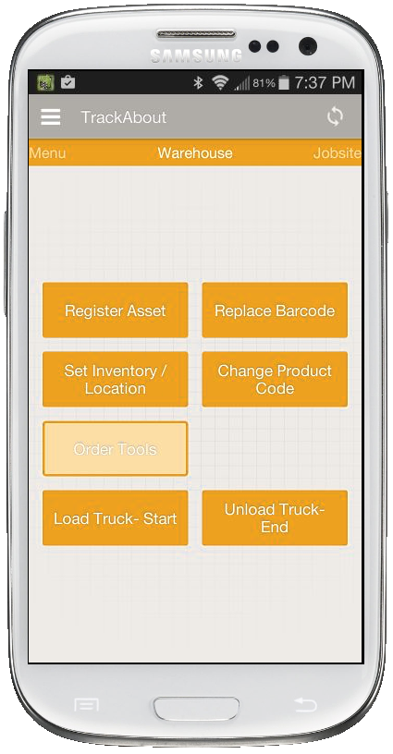
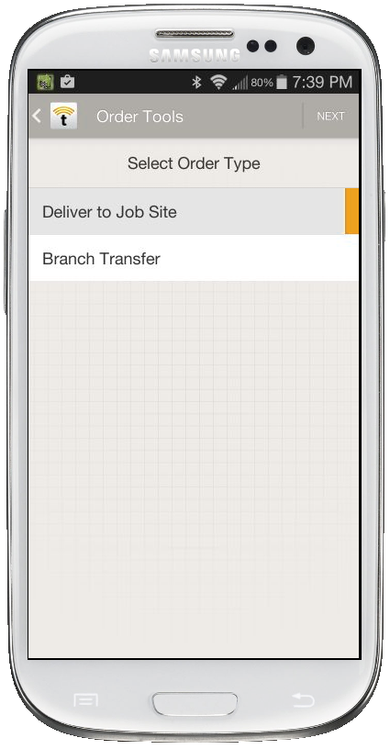
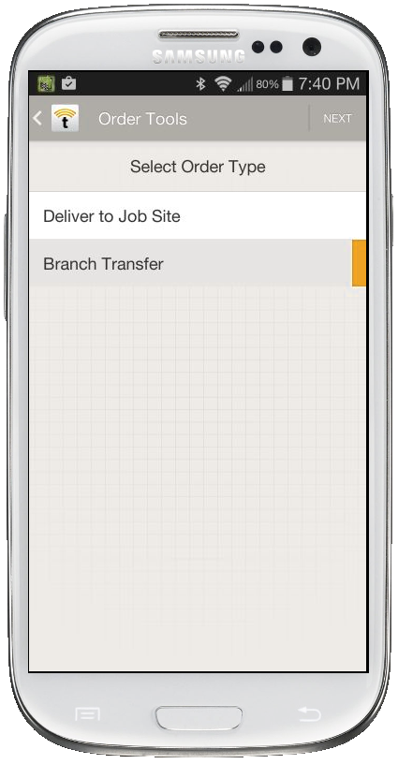
Main Menu & Order Type Selection
Select Branch Transfer for regional transfer requests or requests to add tools to service vans/trucks
(Tool Managers only)
Select Deliver to Job Site for both deliveries and pickup requests at job site
Select Order Tools action

Slide 3
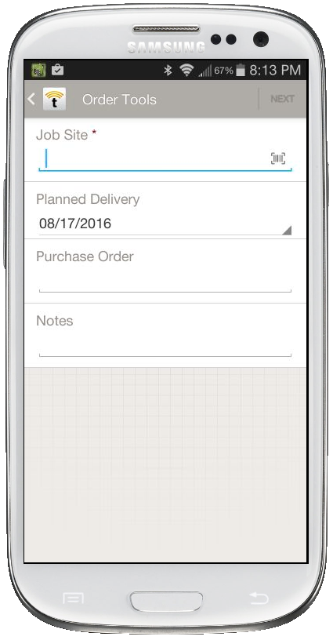
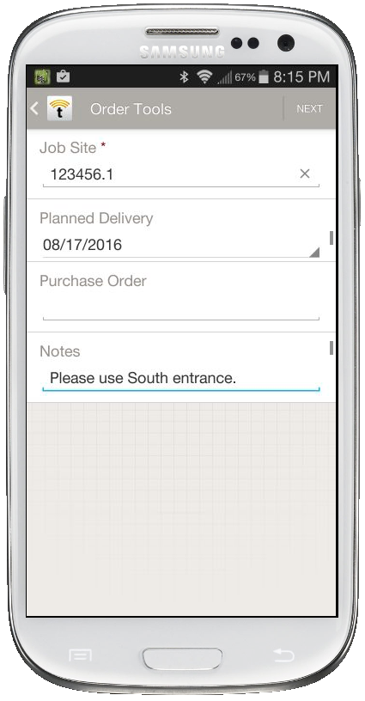
Job Site Order
Job site orders require the entry or scanning of the work order number.
Enter requested delivery date
Enter any order notes
Tap NEXT when complete

Slide 4
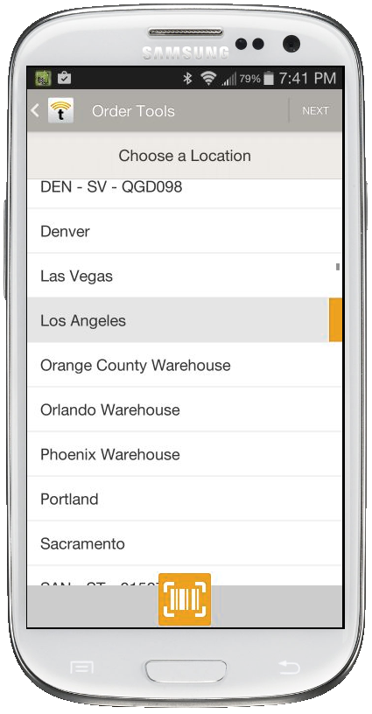
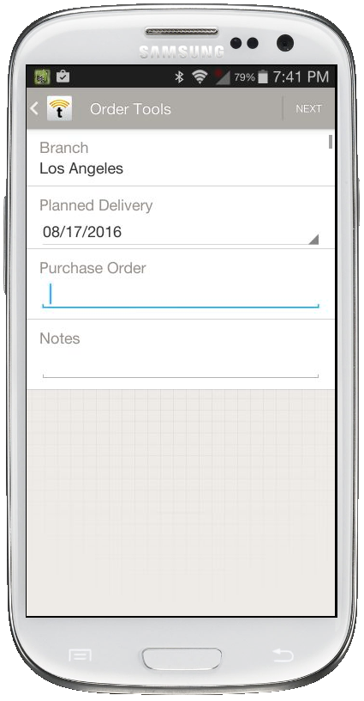
Branch Transfer Order
Enter requested delivery date
Enter any order notes
Tap NEXT when complete
Select the appropriate Location (where tools will be transferred to). Tap NEXT when complete.

Slide 5
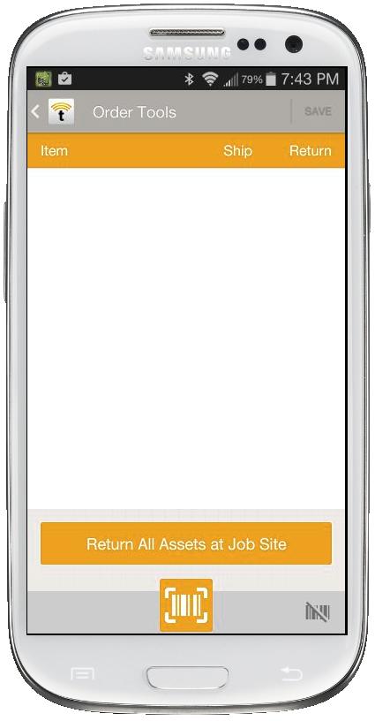
Line Item Entry Screen
Order line items display here
***An order should contain either all Ship or all Return quantities***
Tap to scan barcodes to add a tool of that type to the order
Tap to automatically add all asset counts at entered job site
(not available for transfers)
Tap to enter a line item by searching for a specific product code

Slide 6
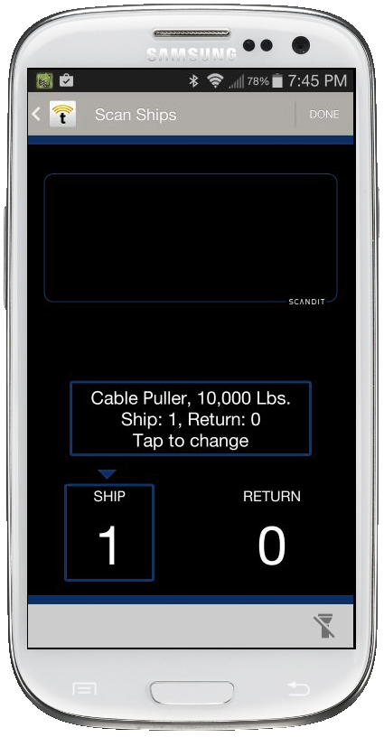
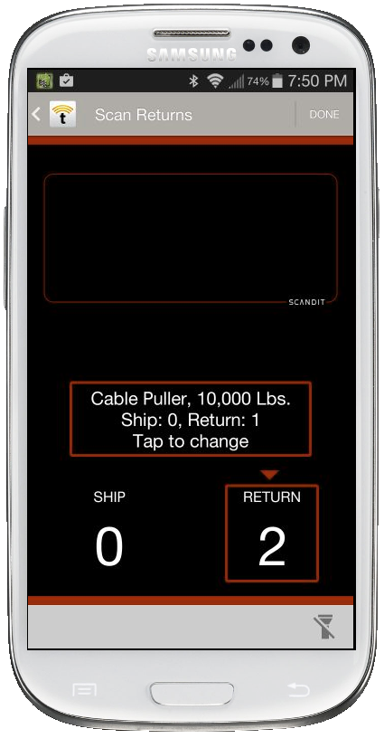
Scan Screen
Toggle between scanning requested ships and returns by tapping the correct column. The screen color will change, as will the heading.
Each asset scanned will increment the overall quantity displayed in the SHIP or RETURN column.
One asset can be scanned multiple times to add to the count of the same asset type.
Tap DONE to finish.

Slide 7
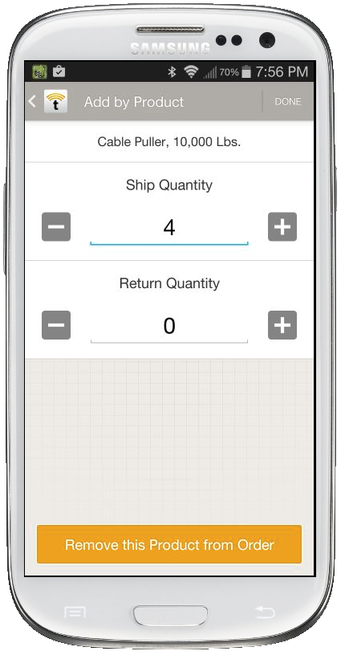
Editing Scanned Assets
You may wish to scan one asset of a certain type and then simply add more of the same product without having to scan.
Tap on the recently scanned product code to adjust quantities.
You can increment/decrement any shipped or returned quantities on the order, and can also remove the product from the order entirely if a mistake was made.

Slide 8
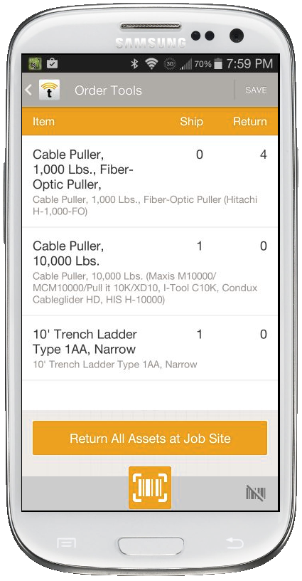
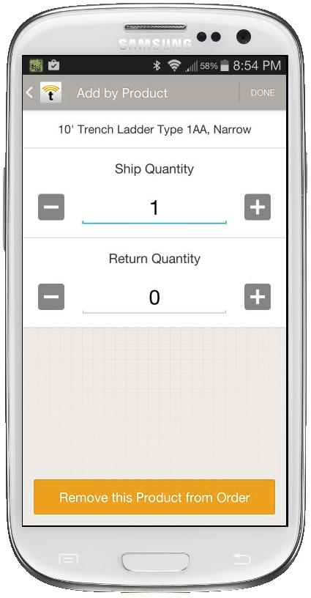
Line Item Entry Editing
As you scan and edit quantities, the order line items list will build.
You may still tap on any line item to adjust quantities or remove the product from the order altogether.

Slide 9
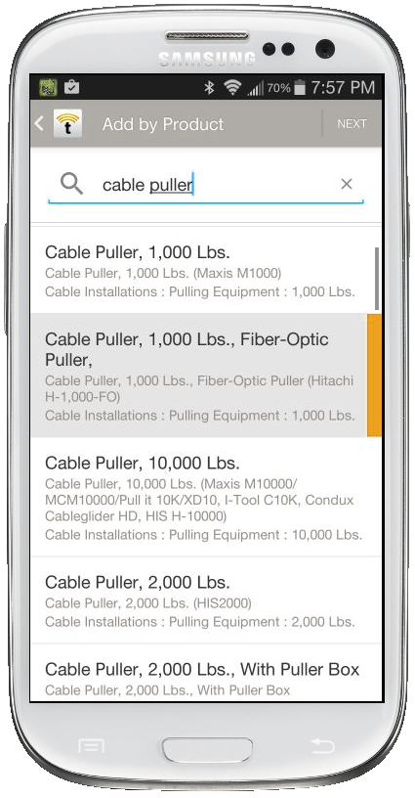
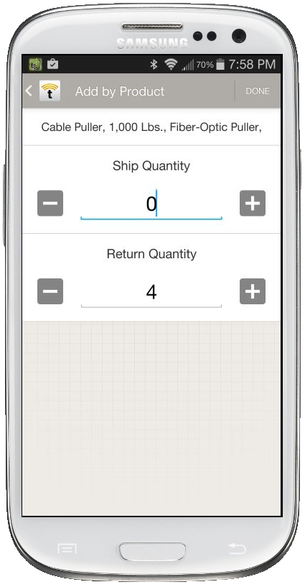
Add by Product Code (no scanning)
To add order line items without scanning, tap the icon from the line item entry screen.
You can then search by term for a product code. Select the appropriate tool and hit NEXT.
Add the requested amount to be shipped or returned and hit DONE.

Slide 10
Final Review
Once all tool types/quantities have been added to the order line items, tap SAVE.
The regional Tool Manager will be notified and will be able to review the order from the TrackAbout website to fulfill the order.

